Slide 1
Industry Exercise 2025
Webinar 2
18 March 2025

Slide 3
Industry Exercise 2025 – Overview
Objective
To build resilience and ensure industry is collectively prepared for a major power system event.
Outcome
So that we as an industry can minimise the impact on consumers as much as possible.
Approach
We have chosen to test a dry winter situation to:
build industry-wide capability to implement rolling outages.
test both operational and communication responses, and the interplay between both.
3

Slide 4
Industry Exercise 2025 Structure
Webinar 1 (4 March, 9:30 – 12:30): Rolling outages process
Learn about industry processes for an extended electricity supply shortage.
Webinar 2 (today, 9:30 – 12:30): Preparing for the Industry Exercise
Understand how the industry exercise will work and what you need to do to prepare.
Industry Exercise (9 April, 9:30 – 15:00)
Take part in the simulated rolling outages exercise.
4

Slide 5
Today’s agenda
09:30 Welcome, housekeeping, overview
09:40 Rolling outage process recap
09:50 Advanced notification of a supply shortage
10:00 Advanced notification of a supply shortage – communication considerations
10:15 Supply shortage declaration
10:25 Direction to reduce consumption and savings targets
10:40 Supply shortage declaration – communication considerations
11:00 Providing us your GXP demand forecast & rolling outage schedule
11:20 What to expect during the exercise
12:00 Crisis communications
12:25 Final wrap up, close
5

Slide 6
Rolling outage process recap Dean Eagle, Market Technical Specialist, Transpower

Slide 7
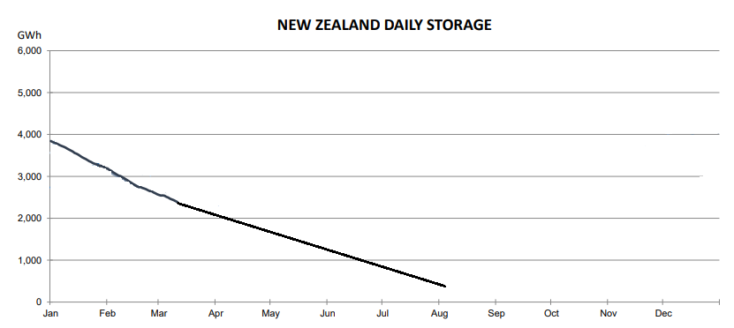
Recap on the process
Scenario – very dry hydro lakes – shortage of electricity supply
Timeline and notifications
7

Slide 8
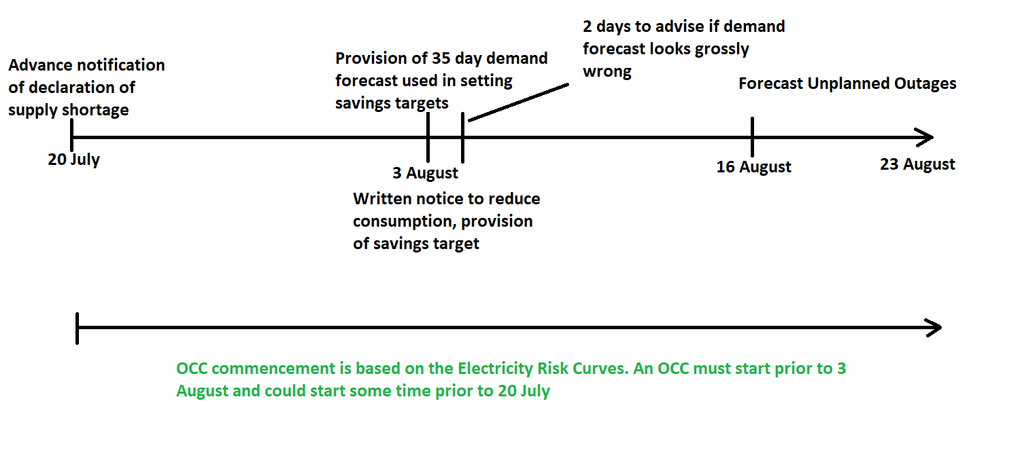
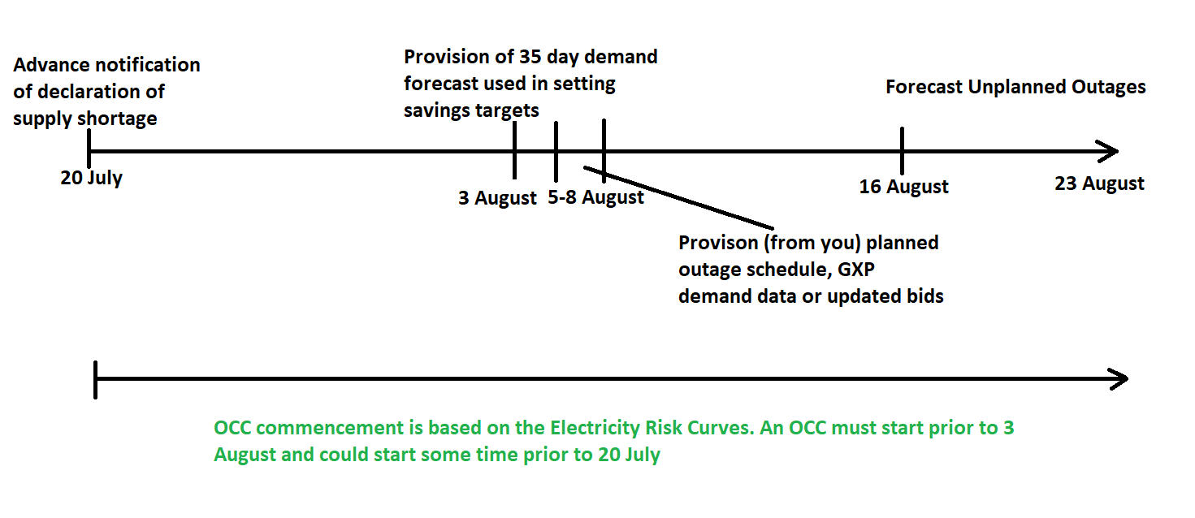
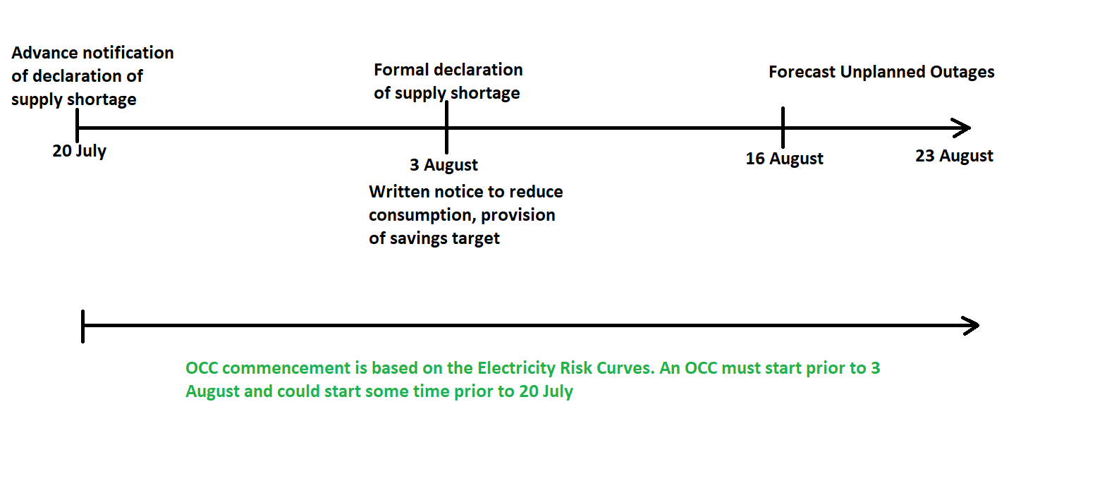
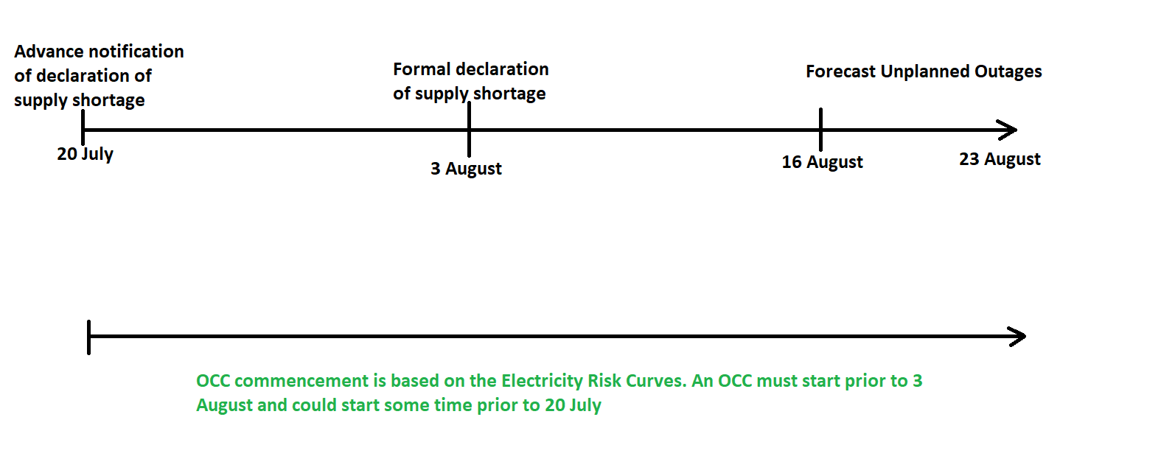
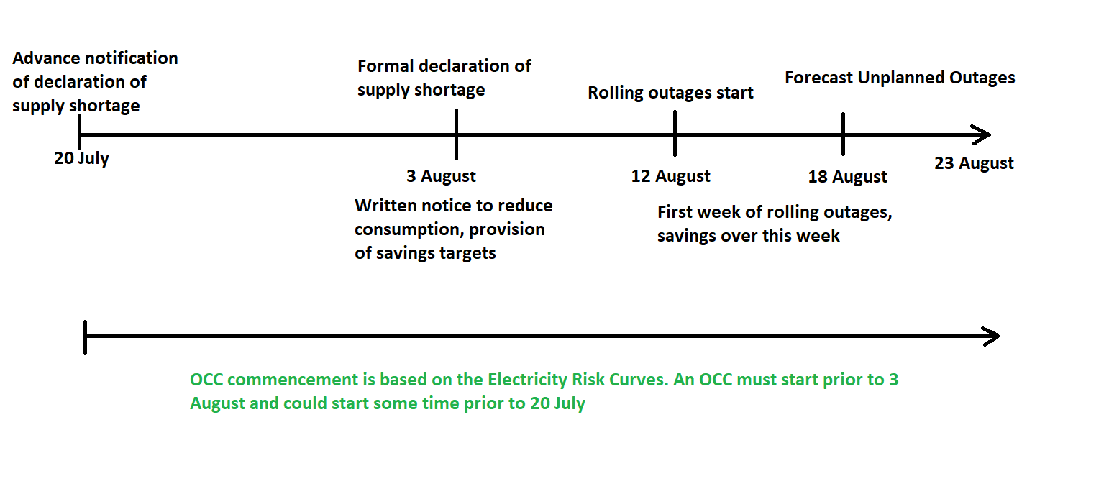
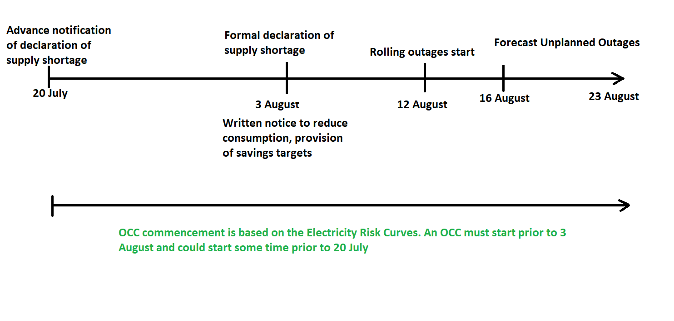
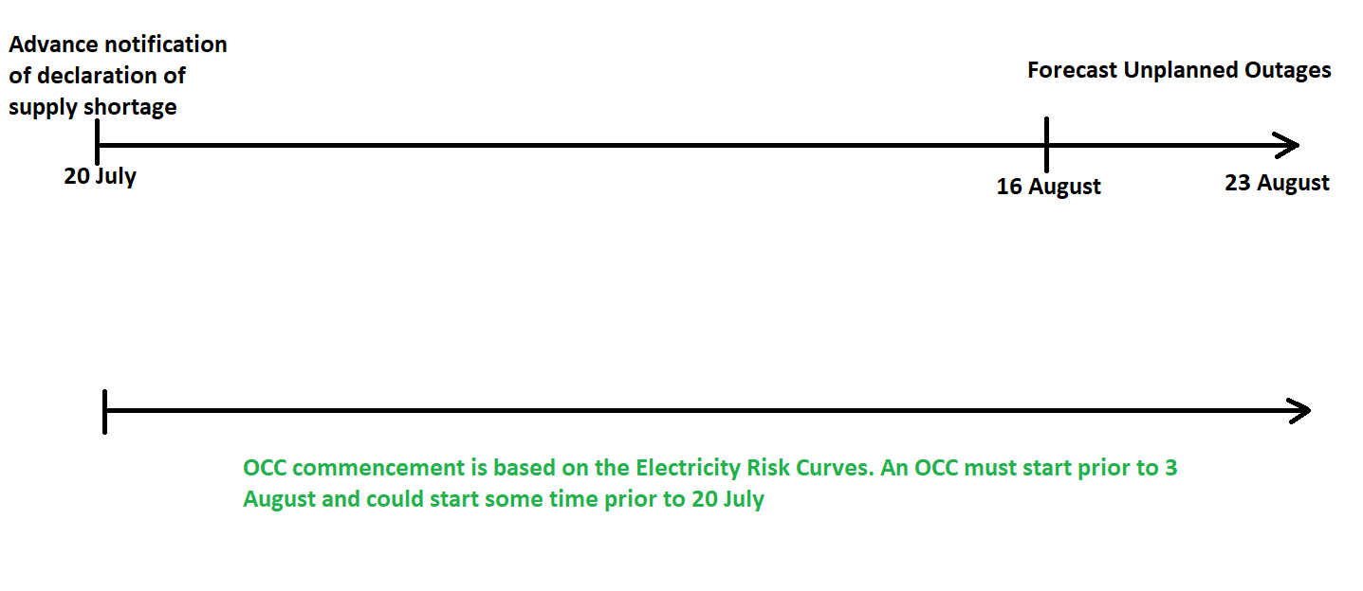
An overview of the process
Possible Timeline
8

Slide 9
Notification timeline
Notification Type
​ | Advance notice of supply shortage​ (CAN) | Formal declaration of supply shortage​ (CAN) | Notice to reduce consumption | GXP demand forecast with reductions | Rolling outages commence​
​Day Number | Day 0​ | Day 14​ | Day 14 | Day 16-19 | Day 23​
Scenario Date | 20 July 2024​ | 3 August 2024​ | 3 August 2024 | 5 August - 8 August 2024 | 12 August 2024​
Actual Date | 18 March 2025​ (this webinar)​ | 18 March 2025​ (this webinar)​ | 18 March 2025 (this webinar) | 2 April 2025 (prior to Industry Exercise) | 9 April 2025​ (Industry Exercise)​

Slide 10
Any questions
Please raise your hand
10

Slide 11
Advanced notification of a supply shortage Dean Eagle, Market Technical Specialist, Transpower

Slide 12
Advance Notification of a Supply Shortage
Advance notification of an impending supply shortage
Prepare for rolling outages
Endeavour to give 14 days notice
12

Slide 13
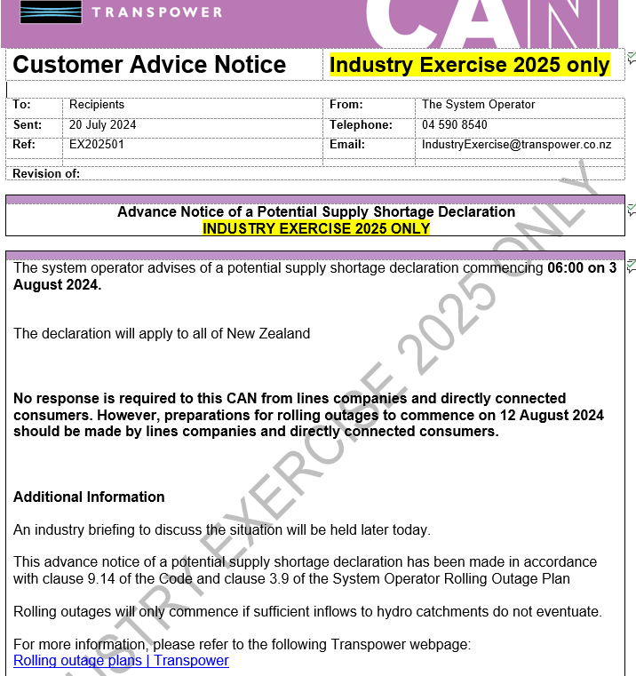
Advance Notification of a Supply Shortage- Notice
13

Slide 14
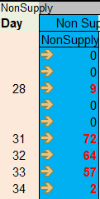
Advance Notification of a Supply Shortage - How did we get to this?
Modelling shows non supply days 28-35+
14

Slide 15
Any questions
Please raise your hand
15

Slide 16
Advanced notification of a supply shortage –communications considerations Nathan Green, Principal Advisor Corporate Communications

Slide 17
Three layers to communications
National Transpower and the Authority
Regional Lines companies
Consumers Retailers
All have a part to play in communicating
Three key levels of communication
Country
Region
Consumer
Different levels hold different information
And different channels
Need to ensure messaging is consistent
Consumer Care Obligations and medically-dependent consumers critical
17

Slide 18
Refresh Official Conservation Campaign (OCC) messaging – and step up campaign
www.savepowernow.govt.nz
18

Slide 19
Advance notice of supply shortage – what Transpower will do?
Our Coordinated Incident Management System (CIMS) response already underway.
Electricity Sector Public Information Manager (PIM) Network set up.
Regular briefings also underway:
Industry briefings – Major Power System Event Contact List, SO Briefing List
Comms-specific briefings – Electricity Sector PIM Network
Government briefings continue alongside Authority and MBIE
Transpower media pack – media briefing, media release, explainers, interviews.
Transpower, Authority and Save Power Now websites updated, OCC campaign revised.
Information shared on Transpower and Authority social media channels.

Slide 20
Advance notice of supply shortage – Transpower messaging
Thank Kiwis for effort, dry conditions persisting and we need to increase OCC efforts.
We have announced an advance notice of a supply shortage. If conditions don’t improve in 14 days we will need to declare a supply shortage.
However, rolling outages will still not start for another nine days – that’s 23 days from today, which is plenty of time for rain.
Rolling outages will reduce demand to mitigate the risk of widespread unplanned outages.
– these are harder for families, businesses and communities to prepare for and manage.
Tips on how to increase energy savings as part of OCC.
If you’re medically dependent on power you should hear from your retailer - if you haven’t make sure you’re registered with them.
We will commit to updating people through Transpower/Authority/OCC websites and social media.

Slide 21
Advance notice of supply shortage – lines company/retailer considerations (1)
For lines companies, it’s time to put your communications and stakeholder plan from your Participant Rolling Outage Plan (PROP) into action:
Is it still fit for purpose?
Who are your key stakeholders, and how will you reach them?
Are you resourced for this?
How will you ensure your messages are aligned with Transpower and Authority?
For retailers, how will you coordinate with lines companies to communicate with customers and stakeholders, and ensure no one falls through the cracks.
Think about Consumer Care Obligations, and what you will do for medically dependent consumers.

Slide 22
Advance notice of supply shortage – lines company/retailer considerations (2)
Lines companies and retailers have specific consumers and stakeholder channels.
How will you reframe messaging for your needs?
What communications will you provide to your consumers and key stakeholders now and as we get closer to a formal declaration?
How do we cater for different levels of understanding, misinformation?
What do you expect to hear from Transpower and the Authority?
We will front media and liaise with government
Toolkit with messaging, explainers
Electricity Sector Public Information Manager (PIM) Network as key channel
What else do you need?

Slide 23
Any questions
Please raise your hand
23

Slide 24
Supply Shortage Declaration Dean Eagle, Market Technical Specialist, Transpower

Slide 25
Declaration of a Supply Shortage
Time jump 14 days to 3 August.
Still no significant rainfall or inflows
Formal declaration of a Supply Shortage.
Requires consultation with the Authority before declaring.
For a shortage of electricity supply need to have already started an Official Conservation Campaign.
25

Slide 26
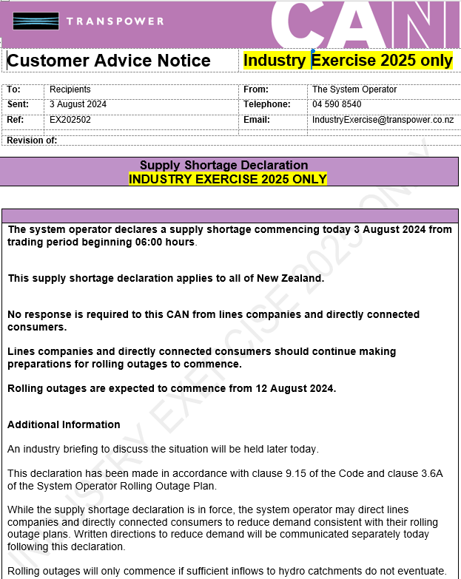
Declaration of Supply Shortage- Notice
26

Slide 27
Any questions
Please raise your hand
27

Slide 28
Direction to reduce consumption and savings targets Dean Eagle, Market Technical Specialist, Transpower

Slide 29
Written direction to reduce consumption and savings targets
The direction will be to reduce consumption, likely this requires rolling outages.
Each written direction sent by email to lines companies and direct connects.
Must be acknowledged by email within 48 hours, unless otherwise specified.
Publish regional targets to our website.
Savings targets (individualised) will be sent within the email.
Endeavour to give 9 days notice of savings targets.
In our scenario rolling outages start 12 August (the exercise on 9 April).
29

Slide 30
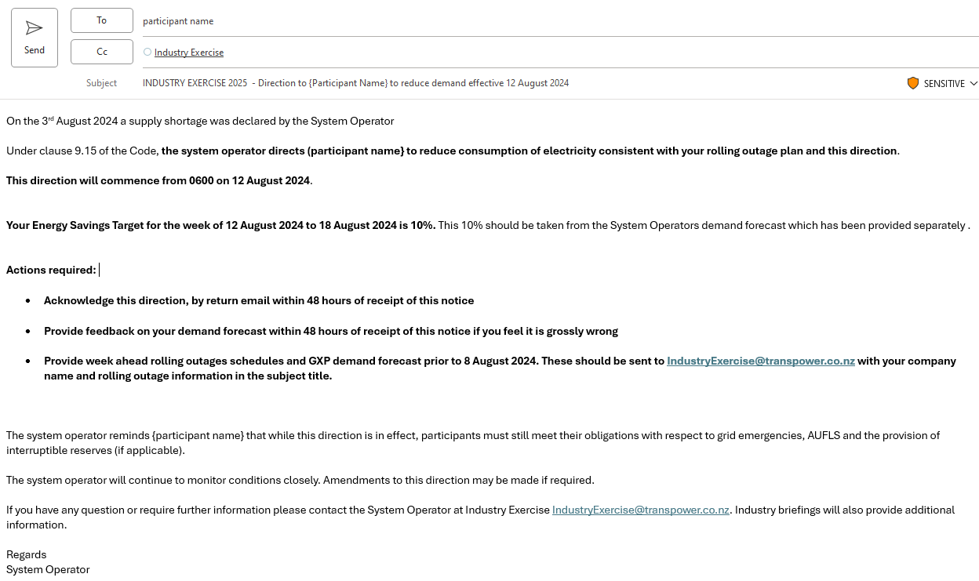
Written direction to reduce consumption and savings targets
Direction to lines companies and direct connects under clause 9.15 of the code, must comply.
Direction takes effect 12 August at 6am
Has a savings target, this is weekly (so 12-18 August)
You need to plan how this will be achieved its not instructed in real time
30

Slide 31
Written direction to reduce consumption and savings targets
Actions to take
Must acknowledge by return email within 48 hours
May provide feedback on demand forecast within 48 hours if it looks grossly wrong
Must provide a GXP demand forecast or outage schedule within 2- 5 days
Savings are a weekly target think MWh not MW
Savings assessed against the forecast, not last years actuals
31

Slide 32
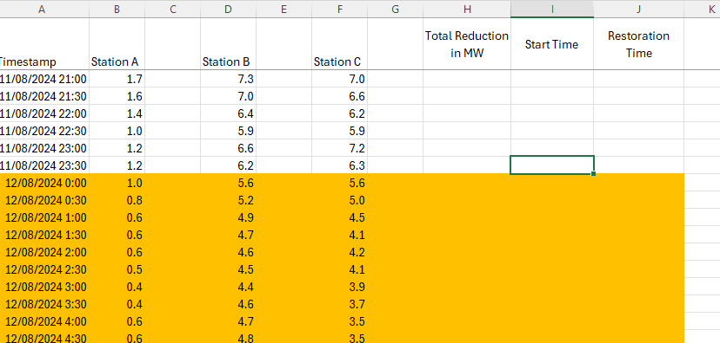
Written direction to reduce consumption and savings targets
32

Slide 33
Written direction to reduce consumption and savings targets
Lines companies – demand taken from same time last year.
Direct connects – demand may be reduced.
Data used to determine:
When to start rolling outages
What your savings targets will be
This data is static 35 days. In reality it would be the next 35 days.
Does not include rolling outages.
You may review and feedback within 48 hours if it looks grossly wrong.
33

Slide 34
Any questions
Please raise your hand
34

Slide 35
Supply shortage declaration – communications considerations Nathan Green, Principal Advisor Corporate Communications, Transpower

Slide 36
Declaration of supply shortage – what Transpower will do?
We will continue to use main channels outlined previously.
Escalating urgency will be reflected in materials and messaging.
Official Conservation Campaign (OCC) will be revised again to show escalating urgency.
We will make regional/lines company savings targets available to media and public, for if rolling outages are needed.
Transpower and Authority will each host a map linking to each lines company
Savings targets will be published by lines company.
If rolling outages needed, links will be to lines company outage information.
Transpower/Authority will also develop method for capturing total number properties on outage by region/across country for government stakeholders and media/public.
Will also establish a cadence for when these numbers are updated.

Slide 37
Declaration of supply shortage – messaging
Thank Kiwis again for efforts, dry conditions have persisted, we are declaring a supply shortage.
This means we will instruct lines companies to begin rolling outages in nine days.
Rolling outages reduce demand to mitigate the risk of widespread unplanned outages.
– these are harder for families, businesses and communities to prepare for and manage.
Timing could shift based on how much we can voluntarily reduce use, and whether we get rain.
We have provided lines companies with savings targets for each week, but how they implement rolling outages is a matter for each company.
You can expect to hear from your local lines company and/or retailer about the potential impact on your supply – please don’t contact them unless you really need to.
If you don’t know who your lines company is, we are providing a map on our website.
Tips on how to get ready – you should have heard from your retailer if medically dependent.

Slide 38
Declaration of supply shortage - lines company/retailer considerations
For lines companies and retailers, how will your messaging change now rolling outages are imminent?
How will you ensure your messages are aligned with Transpower and Authority?
Coordination between lines companies and retailers will be critical as we plan for implementing rolling outages:
How will lines companies work with retailers to develop processes for keeping consumers informed about when rolling outages will affect them – e.g. accessing EIEP5A for planned outages?
If not, what arrangement do you have with lines companies to receive affected ICP information?
How do you coordinate contacting medically dependent consumers with lines companies?
Other considerations
Tools, processes, people
Volume of communications’
Duration and fatigue

Slide 39
Any questions
Please raise your hand
39

Slide 40
Providing us your GXP demand forecast & rolling outage schedule Tim Connolly, Operations Manager, Transpower

Slide 41
Information we require from Direct Connects
Information we require back from direct connects by 2 April:
Week ahead rolling outage schedule
Please use the template emailed to you last week (first day shown below).
Lists GXP, outage start time and outage restore time and MW quantities

Slide 42
Information we require from Lines Companies
Week ahead half hourly GXP demand (take our forecast and subtract your outages).
Please use the same format as PowerCo.

Slide 43
Additional information we require from you
The time it will take to implement reductions and restorations.
This will give us an idea of ramp rates for each Lines Company and Direct Connect.
Plans should include changes in load within an outage duration, and how they will occur.
For instance, will feeders be returned and others disconnected during the outage period?
Do any planned feeder outages require National Grid Operating Centre to operate the feeder circuit breakers
This will give us an idea of workload and resource requirements
Participants should email plans to IndustryExercise@transpower.co.nz at least one week prior to rolling outage commencement (COB 2 April noting the 9 April exercise date)

Slide 44
What we will do with this information
Used to populate a National Coordination Centre rolling outage spreadsheet to facilitate manageable load variations throughout outage durations.
If required, System Operator will discuss changes with lines companies and Direct Connects, to achieve a staggered/manageable plan.
The System Operator will call and follow up with an email approvals to lines companies and Direct Connects once processed and deemed manageable.
Aiming to approve plans at least two days prior to commencement.

Slide 45
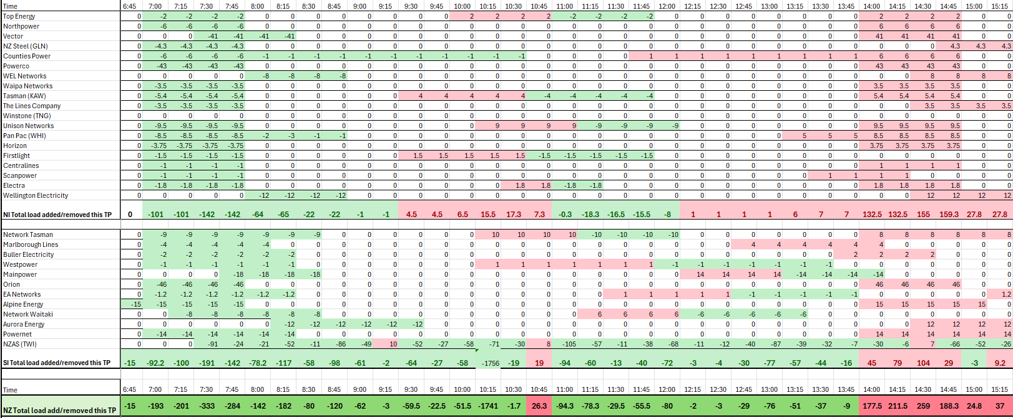
NCC Rolling Outage Spreadsheet

Slide 46
Operational communication
A Customer Advice Notice (CAN) will be sent out via an industry exercise email a day before rolling outages commence to confirm outages are to proceed as planned.
If a plan is approved, no verbal communication with NCC (the Security Coordinator) is required on the day unless plans have changed, or if participants would like to discuss anything.
Any changes >10% of load or >30 minutes outside planned times, should be communicated via email to the IndustryExercise@transpower.co.nz, and verbally to the security coordinator if in real time.
Participants should advise the security coordinator once reductions have been completed. This will help us build an accurate picture of implementation.

Slide 47
Any questions
Please raise your hand
47

Slide 48
What to expect during the exercise Matt Copland, Head of Grid & Systems Operations Manager, Transpower Nathan Green, Principal Advisor Corporate Communications, Transpower Harrison Orr, Head of Resilience, RiskLogic

Slide 49
Industry Exercise 2025
Exercise Objectives
Rehearse industry communication during a major power systems event.
Build familiarity with System Operator communications during a major power systems event.
Build and demonstrate capability and collaboration across industry during a major power systems event.
Identify gaps or opportunities for improvement in tools and processes.
49

Slide 50
Who has registered to be involved?
Lines Companies
Alpine Energy
Aurora Energy
Buller Electricity Ltd
Counties Energy
EA Networks
Electra
Firstlight Network
Horizon Networks
Mainpower
Marlborough Lines
Nelson Electricity
Network Tasman
Network Waitaki Ltd
Northpower
Orion
Powerco
Powernet
Smart Net Limited
The Lines Company
Top Energy
Unison Networks
Vector
Waipa Networks
WEL Networks
Wellington Electricity
Westpower
Direct Connects
Daiken Southland
New Zealand Steel
NZAS
Pan Pac Forest Products
Oji Fibre Solutions
Retailers
2degrees NZ
Contact Energy
Deep Energy
Ecotricity
Electric Kiwi
Flick Electric
For Our Good Ltd
Genesis Energy
K Power Limited
Lodestone Energy
Meridian Energy
Mercury Energy
Nova Energy
Octopus Energy
Orange Services Ltd
Plains Power
Pulse Energy
Rural Energy Retail
Sustainability Trust – Toast Electric
Generators
Contact Energy
Genesis Energy
Manawa Energy
Mercury
Meridian Energy
Pioneer Energy
Other
Electricity Authority
Electricity Networks Aotearoa
ERANZ
Major Electricity Users Group
NEMA
Utilities Disputes
Emergency Management Canterbury

Slide 51
Exercise Structure
Time | Operational Response Stream | Communications Response Stream
9:00 | Welcome, exercise schedule (Everyone via the MS teams meeting invite)
9:10 | Situation update (Everyone via the MS teams meeting invite)
9:30 | Phase 2: Escalation (Rolling outages commence - morning day 1) Lines companies & Direct connects simulate the first 2 hours of rolling outages as per agreed plans (Offline at your premises) | Phase 2: Escalation (Rolling outages commence - morning day 1) Using the RiskLogic social media simulator, communication teams simulate proactive and reactive comms as appropriate for initiation of rolling outages (via MS teams meeting invite)
11:30 | Hot debrief (Everyone via the MS teams meeting invite)
12:15 | Lunch
13:00 | No action other than supporting communication teams as required | Continue communications response (via MS teams meeting invite) Phase 3: Restoration (Partial restoration day 1) Phase 4: Ongoing, fatigue setting in
14:30 | Wrap up (Everyone via the MS teams meeting invite)

Slide 52
Testing our operational response (1)
This stream of the exercise will be focusing on lines companies and direct connects ability to implement rolling outages.
Use your approved demand reductions and outage schedule
Simulate the first two hours of the first day of rolling outages
Note if your first outage starts at 6:30am, that would be your exercise start time.
Include the communication of relevant information to retailers (including EIEP5A data)
Consider standing up and simulating an incident management team
Try to be as realistic as possible in order to test the practicality of your plan
Complete any relevant operational questions in the exercise workbook
52

Slide 53
Testing our operational response (2)
For the purposes of the exercise:
National Coordination Centre will have two coordinators, one Operations Manager
The Security Coordinator (SC) is tasked with managing security of the system during rolling outages
In the first instance, Lines Companies and Direct Connects should discuss any aspects of their situations with the SC as required
National Grid Operating Centre will have one Grid Asset controller (GAC), also acting as an Operations Manager
The GAC will manage switching of GXP feeder circuit breakers under Transpower operational control if requested
Contact information will be provided ahead of the exercise
53

Slide 54
Testing our communications response – ahead of exercise
This stream of the exercise is focused on lines companies and retailers communicating with consumers and other stakeholders ahead of and during rolling outages. Ahead of the exercise:
Fill out the workbook with your comms and engagement approach from the advance notification of a supply shortage and the declaration, and provide the messaging you will use
Develop your communications approach and messaging for the onset of rolling outages in the 9 April exercise, and be prepared to upload to the exercise simulation environment on 9 April as needed
EIEP5A data
Lines companies should upload EIEP5A data to the SharePoint site provided by RiskLogic
Retailers should access EIEP5A data to best approximate extent and location of outages
talk to your operations teams if you don’t know how to use this
Familiarise yourself with Consumer Care Obligations and how they will apply to your communications approach in the lead up to and during the exercise
54

Slide 55
Testing our communications response – during exercise
Roll out real time communications as you would in the lead up to and during outages
Where possible, simulate based on EIEP5A planned outage data from the SharePoint site
If this becomes logistically challenging in the simulation environment, just use general messaging and refer to ‘zone 1’, ‘zone 2’ consumers, or whatever makes sense to you.
Respond to injects into the simulation environment - there will be ambiguity so do your best.
Fill out your workbook as you go – one per organisation, not per participant
A key outcome is to drive cooperation between operations and comms and throughout the sector, and to identify the challenges we face
So work closely with your operations teams to understand their challenges and what that will mean for communication in a real event
Focus on using the exercise to build your internal capabilities, and identify the tools, messaging and resources you may need for the real thing
55

Slide 56
Industry Exercise 2025 – EIEP5A forms
1. SharePoint Folder – EIEP5A Forms
Participants will be provided access to a secure SharePoint folder for respective EIEP5A forms to be uploaded as part of this exercise.
An invitation will be sent to your email during this session. If there are any issues in accessing the SharePoint please contact Harrison Orr at horr@risklogic.com.au
EIEP5A
56

Slide 57
Industry Exercise 2025 – Workbook
2. Exercise Workbook (MS Forms)
Participants will be asked to complete exercise workbooks during the exercise.
Guidance will be provided by facilitators regarding when to complete each section.
Webinar 2 requires you to complete Phase 1 of this workbook.
Throughout the exercise MS Forms will be provided to you for completion. Only one workbook needs to be completed per participating organisation and each workbook will be provided at a specific time during the incident simulation.
If you have multiple attendees from your organisation, please consider how you will communicate during the breakout periods to complete the workbook.
57

Slide 58
Industry Exercise 2025 – Workbook (phase 1)
2. Exercise Workbook – Phase 1
Participants to complete Phase 1 of the workbook by 02 April 2025.
58

Slide 59
Industry Exercise 2025 – Social media simulator
3. Social Media Simulator
Simulated mainstream and social media injects will be shared on a Social Media Simulator platform.
This is a closed system which simulates media platforms and allows participants to share and respond to content.
As part of the exercise, participants will be asked to post examples of your communications to the simulator.
Log in details shall be shared ahead of the exercise and a briefing provided at the start of the exercise.
PLEASE DO NOT POST TO YOUR MEDIA CHANNELS DURING THE EXERCISE
59

Slide 60
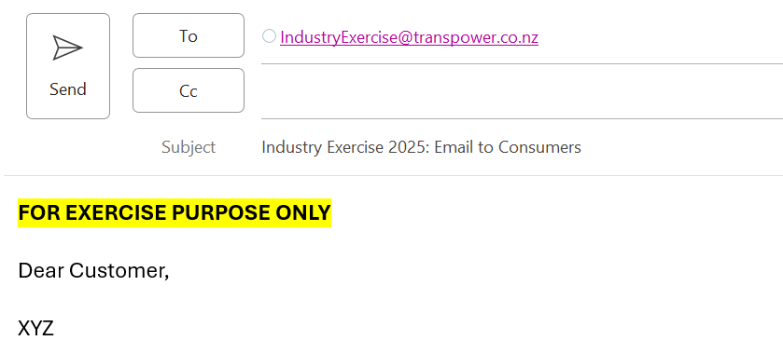
Industry Exercise 2025 – Emails / other content
4. Emails / Other Content
If you would send emails, perform briefings, or share other content with stakeholders as part of your communications strategy, please send these to the following exercise email address:
IndustryExercise@transpower.co.nz
Please ensure the subject line includes:
Industry Exercise 2025…
Please identify all content as:
‘For Exercise Purposes Only’
PLEASE DO NOT SEND EMAILS OR OTHER CONTENT TO STAKEHOLDERS DURING THE EXERCISE
60

Slide 61
Industry Exercise 2025 – Hot debrief / Survey
Hot Debrief
Hot Debrief
Immediately following the core exercise activities in the Morning Session, a hot debrief will be conducted to discuss what worked well, challenges posed by the scenario, and any improvement opportunities.
Participant Survey
Following the exercise, a survey will be sent out to participants to capture your feedback.
61

Slide 62
Possible exercise interactions
Leading up to and during the exercise:
Formal Notices (CANs, WRNs, GENs) – emailed to participants
Media releases – emailed to participants
Acknowledgement of receipt of information – emailed to participants
Meeting invites to Industry Briefings – emailed to participants
Industry Briefings – MS Teams meetings (use existing MS Teams link in main invite)
Verbal control room communications – as per supplied contact information
Inter-organisational communications – may be email or verbal, as per supplied contact information
Note: a list of contacts for the exercise along with other information will be sent the Monday prior, please check your organisational details are correct. Email IndustryExercise@transpower.co.nz for any corrections.
If you didn’t receive the information pack for this webinar, please email IndustryExercise@transpower.co.nz to be added to the exercise distribution list

Slide 63
Exercise communication protocols
Please start all conversations – even with other participants – with “Industry Exercise 2025” and include the phrase in the subject line of any emails or to start text messages or other communications.
All notices and other instructions for the exercise will come from this Industryexercise@Transpower.co.nz email address.
Note that our control centres will be using their normal email addresses for any real-world communications. This means that you should treat anything as real coming from our control centres that is not headed “Industry Exercise 2025”.
If Transpower participants in the exercise need to contact any other participants regarding a real-world event, they will begin the communication with “No duff”. Please do the same if contacting a Transpower participant or any other participant about a real-world event during the exercise.
If we need to cancel the exercise at any point we will email all participants with the subject line “No duff – Industry Exercise 2025 is cancelled”.

Slide 64
Any questions
Please raise your hand
64

Slide 65
Crisis Communications Tim Archer, Head of Communications, RiskLogic
Notes:
[Matt Copland] - handover to RiskLogic
For are next section on Crisis Communication we are lucky enough to be joined by:
Tim Archer is the Head of Communications at RiskLogic, a leading provider of resilience services across Australia and New Zealand.
Tim has worked in corporate communications in Australia for 20+ years including at Channel 7, Rugby Australia and in state and federal politics.
He was Media Manager and Corporate Communications Manager at the NSW Police Force for seven years where critical incidents and major reputational challenges were a daily occurrence.
He now specialises in crisis communications at RiskLogic, helping clients prepare for and respond to cyber attacks, natural disasters, death and injury, corporate misconduct and other major incidents and disruptions.

Slide 66
Crisis Communications Tim Archer, Head of Communications, RiskLogic
Notes:
[Matt Copland] - handover to RiskLogic
For are next section on Crisis Communication we are lucky enough to be joined by:
Tim Archer is the Head of Communications at RiskLogic, a leading provider of resilience services across Australia and New Zealand.
Tim has worked in corporate communications in Australia for 20+ years including at Channel 7, Rugby Australia and in state and federal politics.
He was Media Manager and Corporate Communications Manager at the NSW Police Force for seven years where critical incidents and major reputational challenges were a daily occurrence.
He now specialises in crisis communications at RiskLogic, helping clients prepare for and respond to cyber attacks, natural disasters, death and injury, corporate misconduct and other major incidents and disruptions.

Slide 67
Crisis Communications Tim Archer, Head of Communications, RiskLogic
Notes:
[Matt Copland] - handover to RiskLogic
For are next section on Crisis Communication we are lucky enough to be joined by:
Tim Archer is the Head of Communications at RiskLogic, a leading provider of resilience services across Australia and New Zealand.
Tim has worked in corporate communications in Australia for 20+ years including at Channel 7, Rugby Australia and in state and federal politics.
He was Media Manager and Corporate Communications Manager at the NSW Police Force for seven years where critical incidents and major reputational challenges were a daily occurrence.
He now specialises in crisis communications at RiskLogic, helping clients prepare for and respond to cyber attacks, natural disasters, death and injury, corporate misconduct and other major incidents and disruptions.

Slide 68
Crisis Communications Tim Archer, Head of Communications, RiskLogic
Notes:
[Matt Copland] - handover to RiskLogic
For are next section on Crisis Communication we are lucky enough to be joined by:
Tim Archer is the Head of Communications at RiskLogic, a leading provider of resilience services across Australia and New Zealand.
Tim has worked in corporate communications in Australia for 20+ years including at Channel 7, Rugby Australia and in state and federal politics.
He was Media Manager and Corporate Communications Manager at the NSW Police Force for seven years where critical incidents and major reputational challenges were a daily occurrence.
He now specialises in crisis communications at RiskLogic, helping clients prepare for and respond to cyber attacks, natural disasters, death and injury, corporate misconduct and other major incidents and disruptions.

Slide 69
Crisis Communications Tim Archer, Head of Communications, RiskLogic
Notes:
[Matt Copland] - handover to RiskLogic
For are next section on Crisis Communication we are lucky enough to be joined by:
Tim Archer is the Head of Communications at RiskLogic, a leading provider of resilience services across Australia and New Zealand.
Tim has worked in corporate communications in Australia for 20+ years including at Channel 7, Rugby Australia and in state and federal politics.
He was Media Manager and Corporate Communications Manager at the NSW Police Force for seven years where critical incidents and major reputational challenges were a daily occurrence.
He now specialises in crisis communications at RiskLogic, helping clients prepare for and respond to cyber attacks, natural disasters, death and injury, corporate misconduct and other major incidents and disruptions.

Slide 70
Crisis Communications Tim Archer, Head of Communications, RiskLogic
Notes:
[Matt Copland] - handover to RiskLogic
For are next section on Crisis Communication we are lucky enough to be joined by:
Tim Archer is the Head of Communications at RiskLogic, a leading provider of resilience services across Australia and New Zealand.
Tim has worked in corporate communications in Australia for 20+ years including at Channel 7, Rugby Australia and in state and federal politics.
He was Media Manager and Corporate Communications Manager at the NSW Police Force for seven years where critical incidents and major reputational challenges were a daily occurrence.
He now specialises in crisis communications at RiskLogic, helping clients prepare for and respond to cyber attacks, natural disasters, death and injury, corporate misconduct and other major incidents and disruptions.

Slide 71
Crisis Communications Tim Archer, Head of Communications, RiskLogic
Notes:
[Matt Copland] - handover to RiskLogic
For are next section on Crisis Communication we are lucky enough to be joined by:
Tim Archer is the Head of Communications at RiskLogic, a leading provider of resilience services across Australia and New Zealand.
Tim has worked in corporate communications in Australia for 20+ years including at Channel 7, Rugby Australia and in state and federal politics.
He was Media Manager and Corporate Communications Manager at the NSW Police Force for seven years where critical incidents and major reputational challenges were a daily occurrence.
He now specialises in crisis communications at RiskLogic, helping clients prepare for and respond to cyber attacks, natural disasters, death and injury, corporate misconduct and other major incidents and disruptions.

Slide 72
Crisis Communications Tim Archer, Head of Communications, RiskLogic
Notes:
[Matt Copland] - handover to RiskLogic
For are next section on Crisis Communication we are lucky enough to be joined by:
Tim Archer is the Head of Communications at RiskLogic, a leading provider of resilience services across Australia and New Zealand.
Tim has worked in corporate communications in Australia for 20+ years including at Channel 7, Rugby Australia and in state and federal politics.
He was Media Manager and Corporate Communications Manager at the NSW Police Force for seven years where critical incidents and major reputational challenges were a daily occurrence.
He now specialises in crisis communications at RiskLogic, helping clients prepare for and respond to cyber attacks, natural disasters, death and injury, corporate misconduct and other major incidents and disruptions.

Slide 73
Crisis Communications Tim Archer, Head of Communications, RiskLogic
Notes:
[Matt Copland] - handover to RiskLogic
For are next section on Crisis Communication we are lucky enough to be joined by:
Tim Archer is the Head of Communications at RiskLogic, a leading provider of resilience services across Australia and New Zealand.
Tim has worked in corporate communications in Australia for 20+ years including at Channel 7, Rugby Australia and in state and federal politics.
He was Media Manager and Corporate Communications Manager at the NSW Police Force for seven years where critical incidents and major reputational challenges were a daily occurrence.
He now specialises in crisis communications at RiskLogic, helping clients prepare for and respond to cyber attacks, natural disasters, death and injury, corporate misconduct and other major incidents and disruptions.

Slide 74
Crisis Communications Tim Archer, Head of Communications, RiskLogic

Slide 75
Final wrap up, Close Matt Copland, Head of Grid & Systems Operations Manager, Transpower

Slide 76
Information required by 2 April
Lines companies and direct connects should acknowledge receipt of direction to reduce consumption and savings targets by COB tomorrow
Please provide the following information by 2 April 2025:
Lines companies and direct connects should submit
forecast demand reductions and/or outage schedules
send the information to IndustryExercise@transpower.co.nz
EIEP5A or another method to advise retailers of affected ICPs
Upload to SharePoint
Retailers, lines companies, and direct connects should submit their completed phase 1 workbooks.
76

Slide 77
Wrap up
Industry Exercise (9 April, 9:30 – 15:00) – Join the MS Teams invite
A copy of today’s slide deck along with a recording of the webinar will be uploaded to the Transpower website, along with Q&As
Any queries about today’s webinar please email IndustryExercise@transpower.co.nz
You will be provided with:
a set of instructions on how to use the RiskLogic simulator
contact information for exercise participants
additional workbook phases
access to a SharePoint site to upload and view completed EIEP5A files
Please read and follow any instructions provided.
77

Slide 79
Thank you

